Slide 1
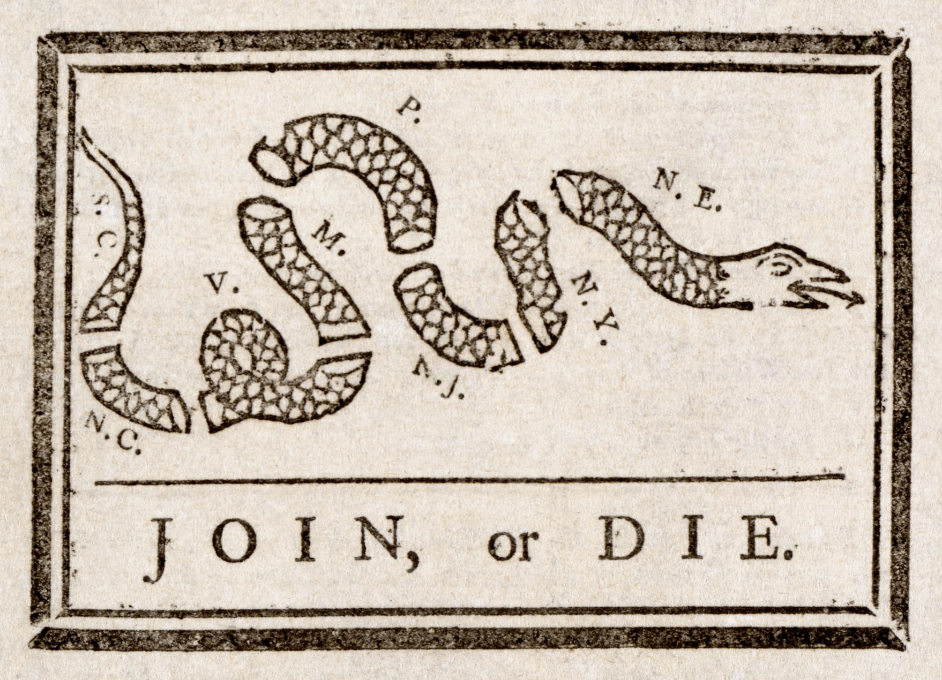
5-1

Slide 2
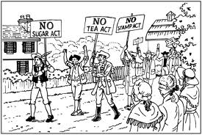
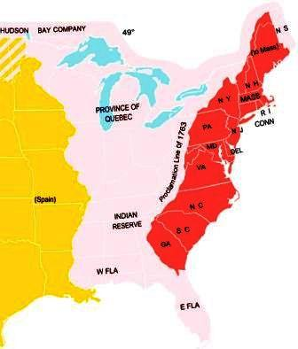
Relations With Britain (Pages 132–134)
A. A feeling of distrust between the colonists and Britain grew due to 1. British soldiers stationed in the colonies and on the frontier
2. the Proclamation of 1763
3. the passing of trade laws and the Sugar Act

Slide 3
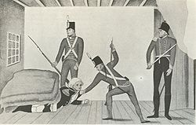
Colonists feared that British soldiers might interfere with their liberties, and they saw the proclamation as limiting their freedom.
B. George Grenville, the British finance minister, began to watch colonial trading more closely in order to catch colonists who were involved in smuggling. In 1764, customs officials were able to obtain writs of assistance to search homes and warehouses for smuggled goods. Colonists were outraged by this intrusion without warning.

Slide 4
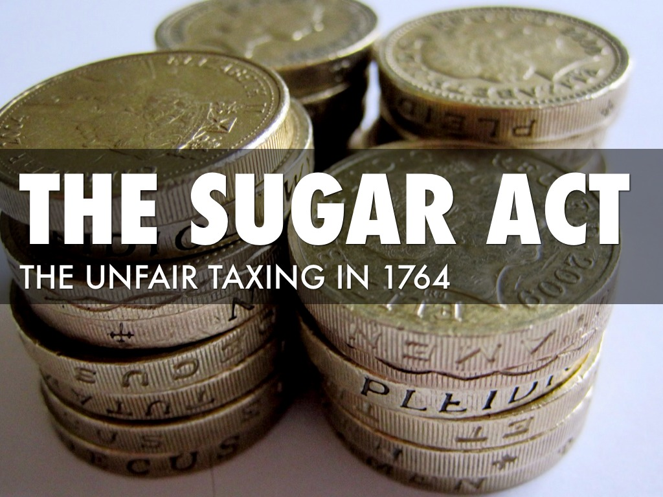
C. Parliament passed the Sugar Act in 1764 to stop the molasses smuggling between the colonies and the French West Indies.
1. The act lowered the tax on imported molasses.
2. The British hoped that by lowering the tax, the colonists would be encouraged to pay the duty on foreign molasses. When Britain collected the taxes, its revenues would increase.
3. The Sugar Act also allowed special courts that had judges, not juries, to hear smuggling cases. The colonists were outraged again because this took away their basic right of trial by jury.

Slide 5
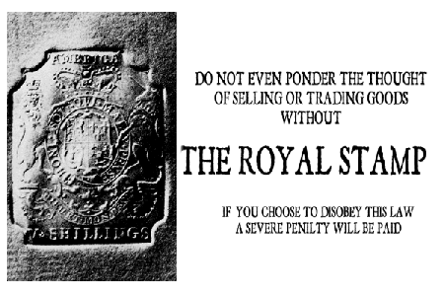
The Stamp Act (Page 134)
A. The Stamp Act taxed almost all printed material in the colonies such as newspapers, pamphlets, wills, and playing cards. British officials placed a stamp on all printed materials. Colonists were opposed because the British Parliament taxed the colonists directly, and it had passed the act without their consent.

Slide 6
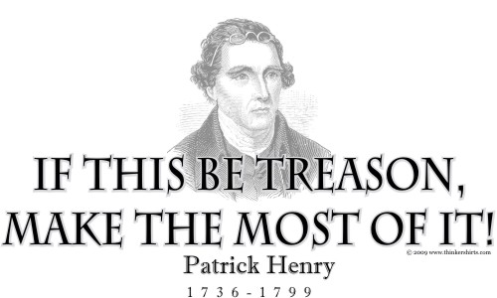
B. The colonists protested this act.
1. In Virginia, Patrick Henry, although accused of treason by his opponents, persuaded the burgesses to take action against the Stamp Act. They passed a resolution saying that they had the “sole exclusive right” to tax their citizens.

Slide 7
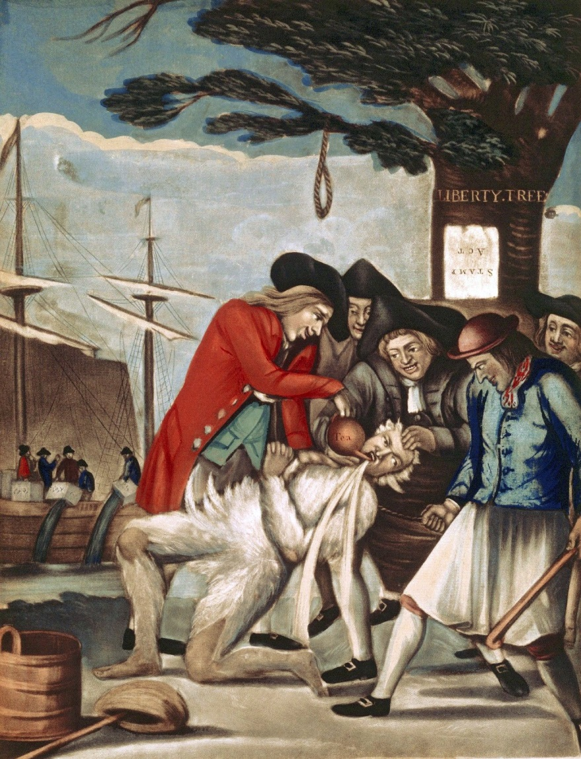
2. The Sons of Liberty, originally organized in Boston by Samuel Adams, protested by burning effigies, raiding and destroying houses of British officials, and marching along the streets to protest Britain’s taxing of Americans.
3. Boycotts against importing British and European goods occurred. Nonimportation agreements signed by merchants, artisans, and farmers hurt British merchants.

Slide 8
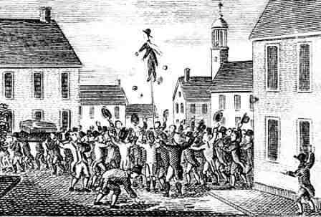

Slide 9
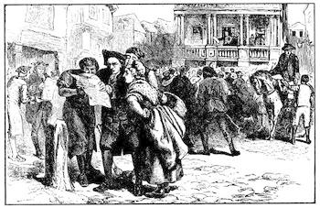
C. In October, Congress petitioned the king and Parliament saying that only their own assemblies could tax the colonies. In March 1766, Parliament repealed the Stamp Act.
D. Parliament passed another act, the Declaratory Act of 1766, on the same day it repealed the Stamp Act. The act allowed Parliament the right to tax and to make decisions for the British colonies “in all cases.”

Slide 10
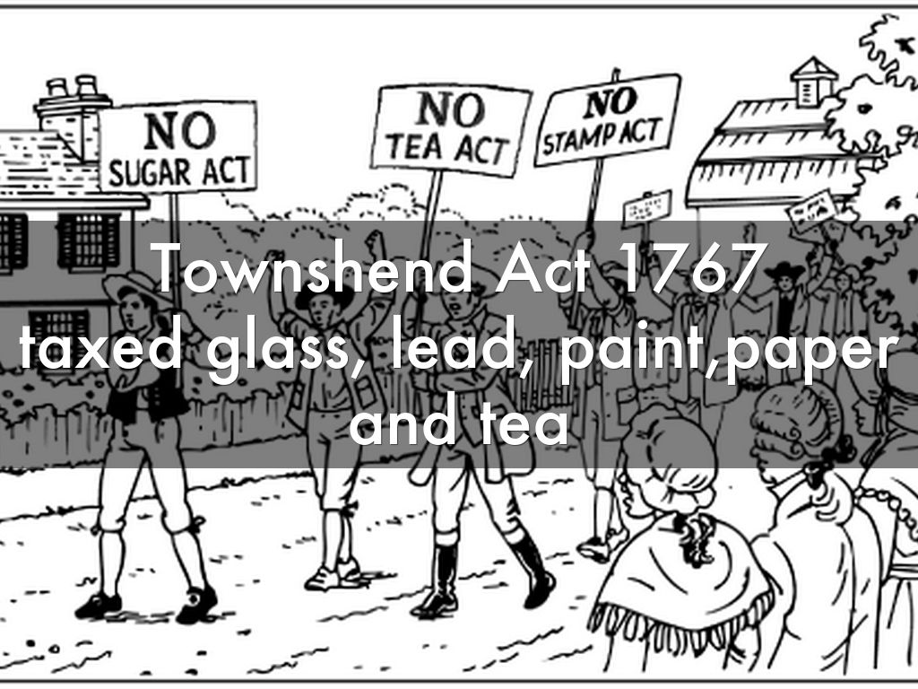
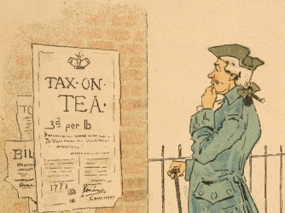
New Taxes (Page 135)
A. Parliament passed the Townshend Acts in 1767, which taxed imported goods at the port of entry. It taxed basic items such as glass, tea, paper, and lead––items that the colonists did not produce and therefore had to import.
B. Another boycott occurred in hopes of showing Britain that only the colonies’ representatives had the right to tax them. The Daughters of Liberty, an active group in the protest, urged Americans to wear homemade fabrics and produce other goods so as not to buy British products.

Slide 11
https://www.youtube.com/watch?feature=oembed&v=Na3pq9wqJlA

