Slide 1
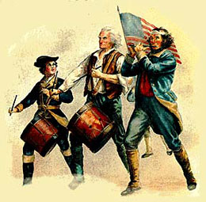

Slide 2
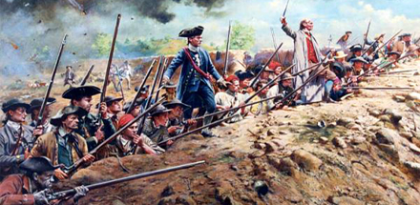
The Opposing Sides (Pages 162–166)
A. In order for the colonies to actually gain their independence from Britain, they had to fight a war. No one expected it to last so long, however.

Slide 3
Why did the thirteen colonies have to fight a war if they declared their independence from Britain?

Slide 4
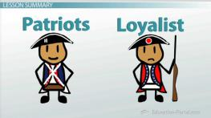
B. The Patriots, or Americans who supported independence, faced several obstacles:
1. Britain had a larger population––8 million against 2.5 million.
2. Britain had the strongest navy in the world and a well-trained army as well.
3. The Americans did not have a regular army or navy. Many colonists belonged to militias who were basically volunteers and served for short periods of time.
4. Not all Americans supported the war effort. Some were neutral, some were opposed to fighting, and some were loyal to Britain.

Slide 5
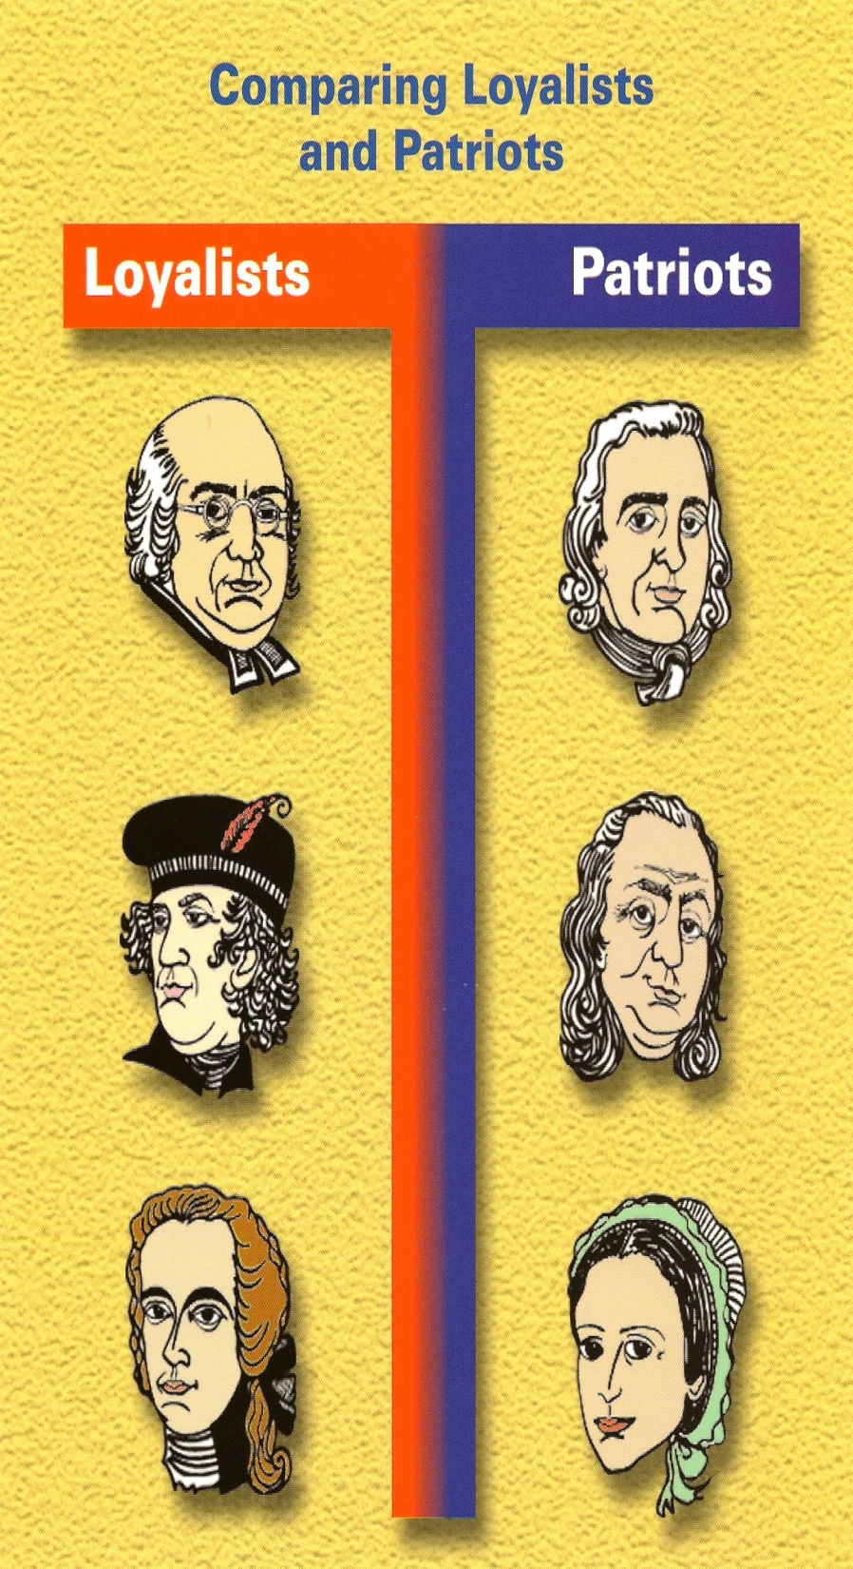
C. The Loyalists, or Tories, supported Britain for several reasons:
1. Some were members of the Anglican Church and thus loyal to Britain.
2. Some depended on the British for jobs.
3. Some feared the changes a new government might bring and feared challenging an existing government.
4. Some just did not understand the war.
Loyalist strength varied from region to region but was strongest in the Carolinas and Georgia.

Slide 6
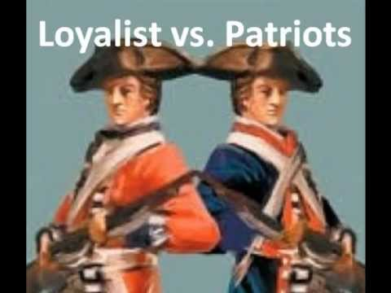
E. The Patriots had some advantages over the British troops.
1. They fought on their own ground, not 3,000 miles from home.
2. They had a personal stake in fighting to protect the freedom of their own land as opposed to the Hessian mercenaries, or hired soldiers, who fought for the British for money.
3. George Washington was a leader with courage, honesty, and determination.

Slide 8
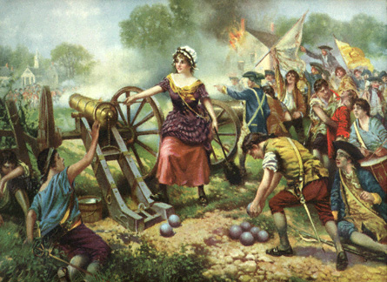
F. Raising an army was difficult. Congress had trouble enlisting soldiers and raising money to fight the war. The Americans had militias, not a regular army. Soldiers usually signed up for one year of service. The Congress offered a three-year term, or length of service, but the one-year enlistment was most common.
G. Some women also fought in the war as Patriots.

Slide 9
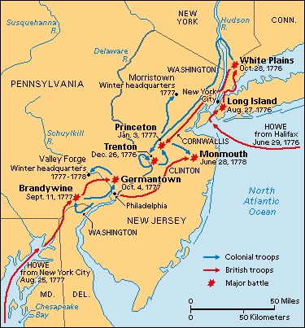
Fighting in New York
A. The British troops outnumbered the Americans. During the summer of 1777, Britain sent 32,000 troops to fight in America. The British hoped to win an early victory.
B. The British defeated the Continental Army at the Battle of Long Island in August. Nathan Hale became a hero for America. He was discovered as a spy and hanged. After the defeat, Washington retreated to Manhattan and then across New Jersey into Pennsylvania, pursued by the British.

Slide 10
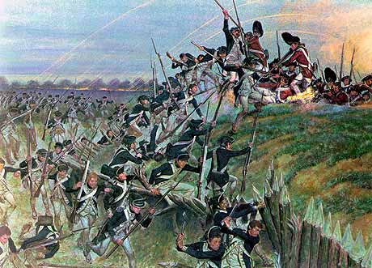
C. The Continental Army faced many obstacles. They ran short of supplies. The size of the army shrank. Soldiers became discouraged. Some soldiers finished their term of service and went home. Others ran away.

Slide 11
Discussion Question
What if the term of service for the armed forces had been a mandatory three-year term or the length of the war, not just the one-year term? Would the Americans have had an advantage and won the war earlier?

Slide 12
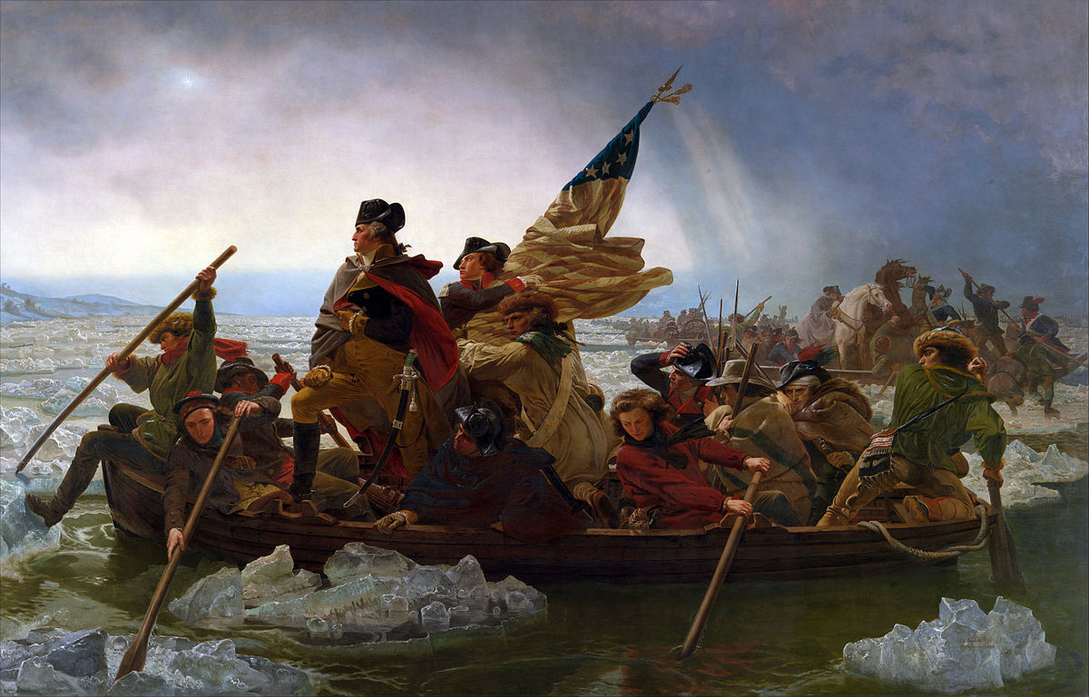

Slide 13
“THESE are the times that try men's souls. The summer soldier and the sunshine patriot will, in this crisis, shrink from the service of their country; but he that stands by it now, deserves the love and thanks of man and woman.

Slide 15
Gaining Allies (Pages 172–175)
A. European nations helped the American cause. France and Spain were at war with the British in Europe and hated the British. They realized that the Americans had a chance to win their war, so they offered assistance.
B. France at first secretly gave money to help the American war effort and then publicly announced its support. In February 1778, the French and the Americans worked out a trade agreement and an alliance. France declared war on Britain and gave the Americans money, equipment, and troops to fight the British.

Slide 16
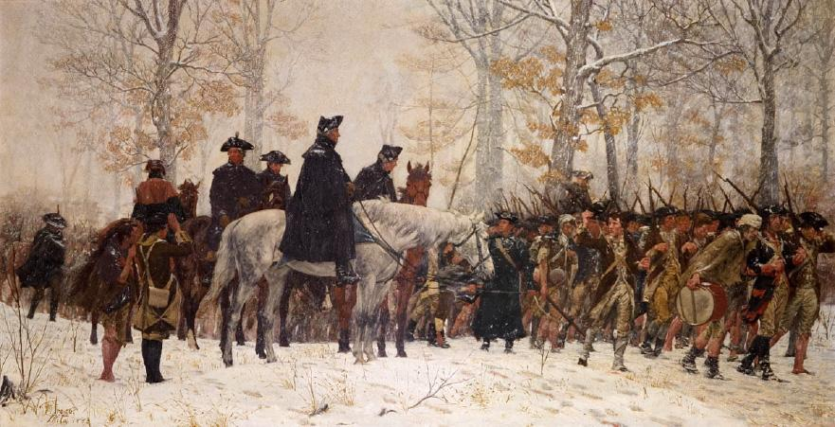
D. Washington’s troops spent a hard winter at Valley Forge, Pennsylvania. The army lacked enough food, clothing, and shelter. Some men deserted; others resigned. Yet the Continental Army survived. In April news of France’s alliance cheered them.

